Slide 1


Semester Project Final Presentation
Automated propeller geometry measurement
from 3d scanning data
LIS
Supervisors :
Professor D. Floreano
S. Steffen
A. Bhaskaran
Author:
P. Maury Laribière
Notes:
Automation propeller geometry measurement
From 3D scanning data

Slide 2
Introduction: Goal of the Project
Performance
analysis
Blade Element Momentum Theory
Shape
Problem :
- Shape is not given
- No common database
Notes:
Want to compute performance of drones
Therefore: use the BEMT. Theory based on shape of propeller to determine its aerodynamics
Pb: Shape not given. No common global database for professional drone engineer.
→ Difficult to obtain dat

Slide 3
Introduction: Goal of the Project
Blade Element Momentum Theory
Shape
3D scanning
Solution :
Reverse engineer shape
Project:
Analyze STL file
Output geometric parameters
Input for external softwares for further analysis
Notes:
Possibility: 3D scan propeller and compute shape and parameters on it to then be able to use the BEMT
‘Reverse engineering’ project of the shape
Analyse and process STL file to output geometric parameters the can be used afterwards as input in external softwares for aerodynamic studies

Slide 4
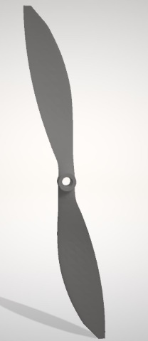
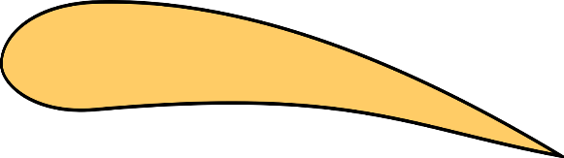
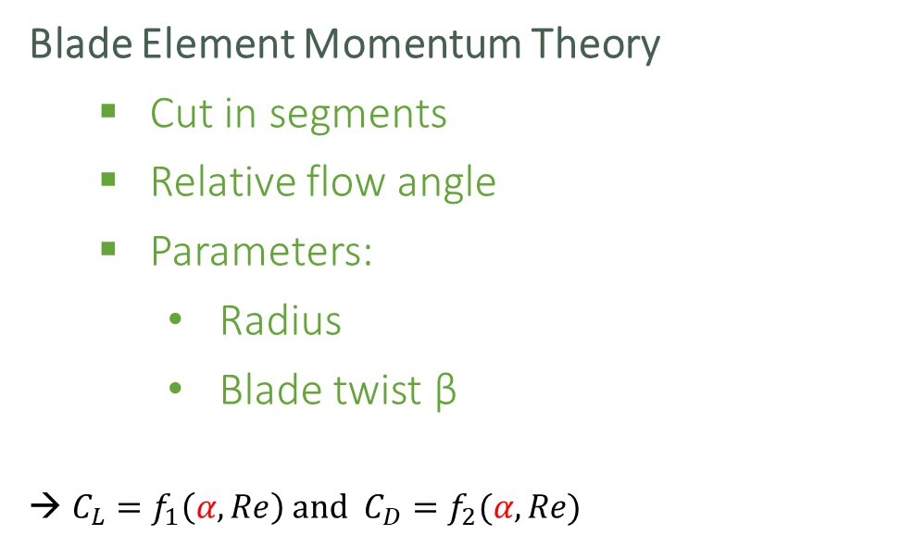
Introduction: Initial concepts
Blade Element Momentum Theory
Cut in segments
Relative flow angle
Parameters:
Radius
Blade twist β
${C_{L}=f}_{1}\left(α, Re\right)$ and ${C_{D}=f}_{2}(α, Re)$
Lift
Air velocity
Drag
α = β - φ
β
φ
Rotation
Notes:
Basically,
BEMT is a theory that cuts the blade in segments along the radius
Computing relative air flow between air velocity and blade twist, get alpha parameter
Then lift and drag coefficients are a function of this alpha and Reynolds number
Compute propeller aerodynamic

Slide 5
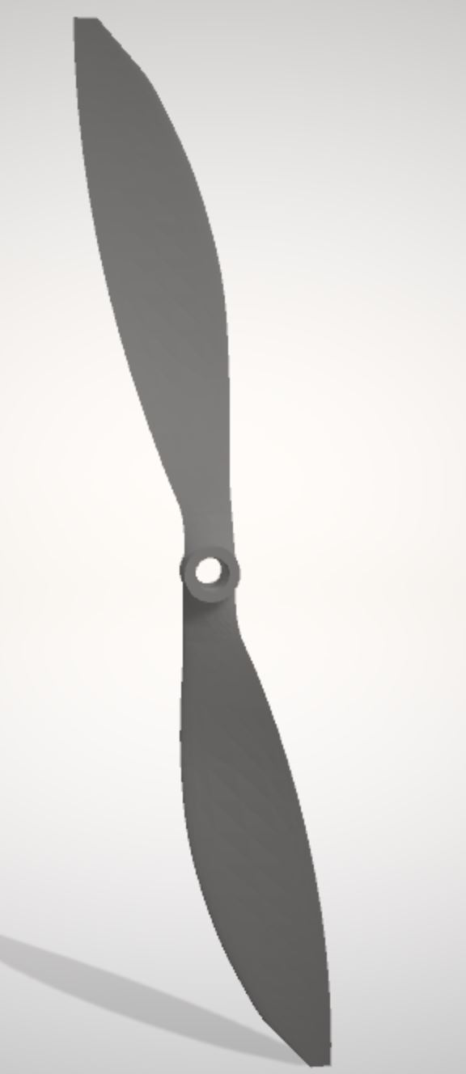
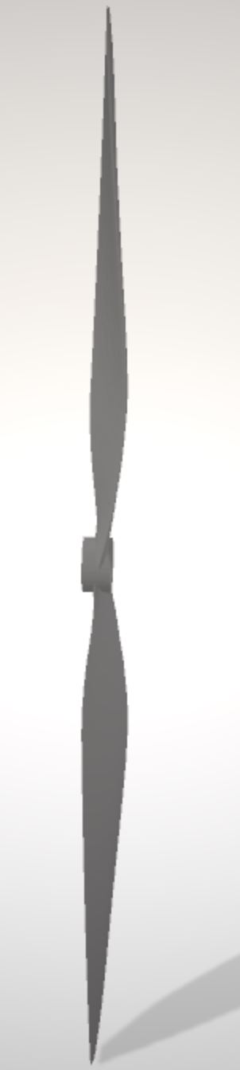
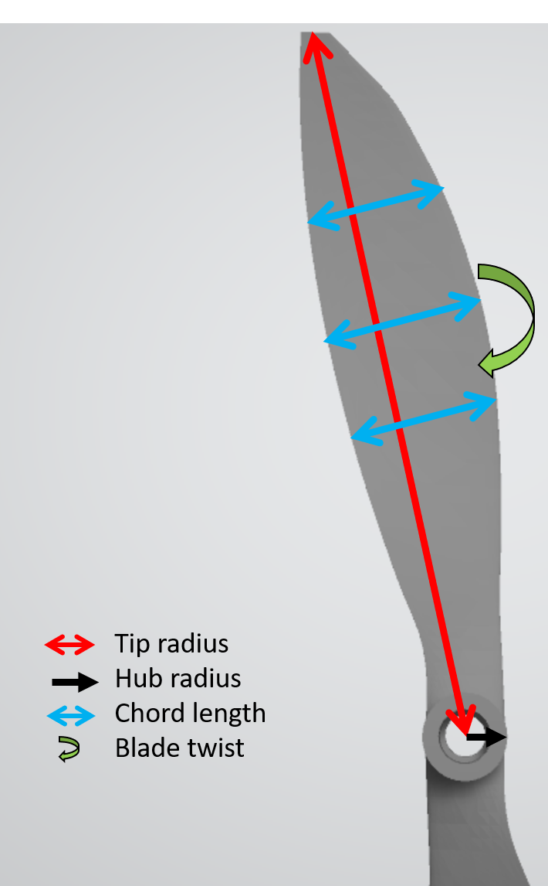
Introduction: Initial concepts
Important geometric parameters
Aerofoil
Chord length
Blade twist
Tip radius
Hub radius
Aerofoil
cross-section
Notes:
Here are the important parameters of a blade:
Aerofoil : cross section when cut blade
Chord length : length from the tow extremities of the aerofoil
Blade twist : angle between aerofoil and plane of the hub of the propeller
Tip radius: length of the blade
Hub radius: radius of the central hole

Slide 6
Introduction: State of the art
Choices for 3D Scanning:
1. Contact
2. Non Contact Active
3. Non Contact Passive
CMM
[1]
Structured Light
[2]
Time of flight
[2]
Laser triangulation [2]
Photogrammetry
[3]
5 main techniques
Notes:
There is no datasheet available to point out one solution to scan
There are different methods to generate point cloud
5 main techniques to choose from
Contact : CMM: probe physically touches a firmly fixed object at several points and samples the different positions of the surface
2. Non contact active ----- rely on the emission of radiation or light.
Structured Light: Emit a pattern of light. Deduce shape measuring deformation of the pattern on the object
Time of flight: Laser beam projected onto surface and collected by a sensor. ToF of laser beam between its emission and reception provides geometrical information
Laser triangulation: Depending on distance object, reflected light falls at angle on receiving element. Determining spot position, distance object-receiverand hence the shape is computed
3. Non contact Passive: Photogrammetry: reconstructs a 3D model object from 2D digital pictures taken at different angles. Reconstruct image with software
Potentially best choice for future project as cheapest, dense point cloud and can adapt to any propeller size (just change camera lens)

Slide 7
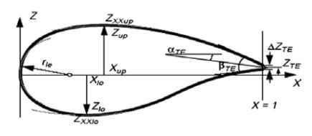
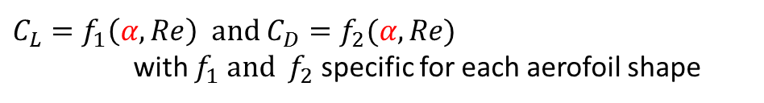
Introduction: State of the art
Cross section (= aerofoil shape) parametrisation
Bézier [4]
Parsec [4]
Sobieczky (with PARSEC) [5]
Improved Parameter Geometric [6]
4th Order Polynomial
Exemple : Parsec parametrisation
${C_{L}=f}_{1}\left(α, Re\right)$ and ${C_{D}=f}_{2}(α, Re)$
with $f_{1}$ and $f_{2}$ specific for each aerofoil shape
Fig 5: PARSEC parametrisation parameters [4]
Notes:
Once scanning data, need to know how to parametrize aerofoil
Many techniques which uses different features
Bezier: polynomials curves
Parsec parameters -- improved
Less parameters: IPG
this project: 4th order polynomial
Shape of aerofoil affects the lift and drag of the section as F1 and f2 specific to each shape

Slide 8

Introduction: State of the art
Comparison table for aerofoil parametrisation
 | Bézier | Parsec | Sobieczky (with Parsec) | IGP | Polynomial 4th order | Polynomial other order
Computable on datapoints
Good fit of aerofoil shape
Notes:
Here parametrize with 4th order polynomial
Computable on datapoints (other would have first needed interpolation to then compute parameters or control points)
Fit the shape well (2 to 3 unflection point)
Other are more useful for optimizing and less for reverse engineering

Slide 9
Methodology : Algorithm Overview
Step 0:
3D scanning
(Photogrammetry)
Step 1:
Propeller Pre-processing
Step 4 : Curves interpolation
(4th order polynomial)
Step 5:
Point output for aerodynamic Software
Step 3:
Aerofoil Side assignment
Step 2:
Aerofoil Points selection
Step 6:
Parameters computation
Notes:
The algorithm consists of 6 main steps that I will explain in the following slides.
They should be preceded be the step 0 where the propelller is scanned and the data is stored
Then a step of pre-processing
4 steps to compute and output the aerofoil shapes
A step for the parameters

Slide 10
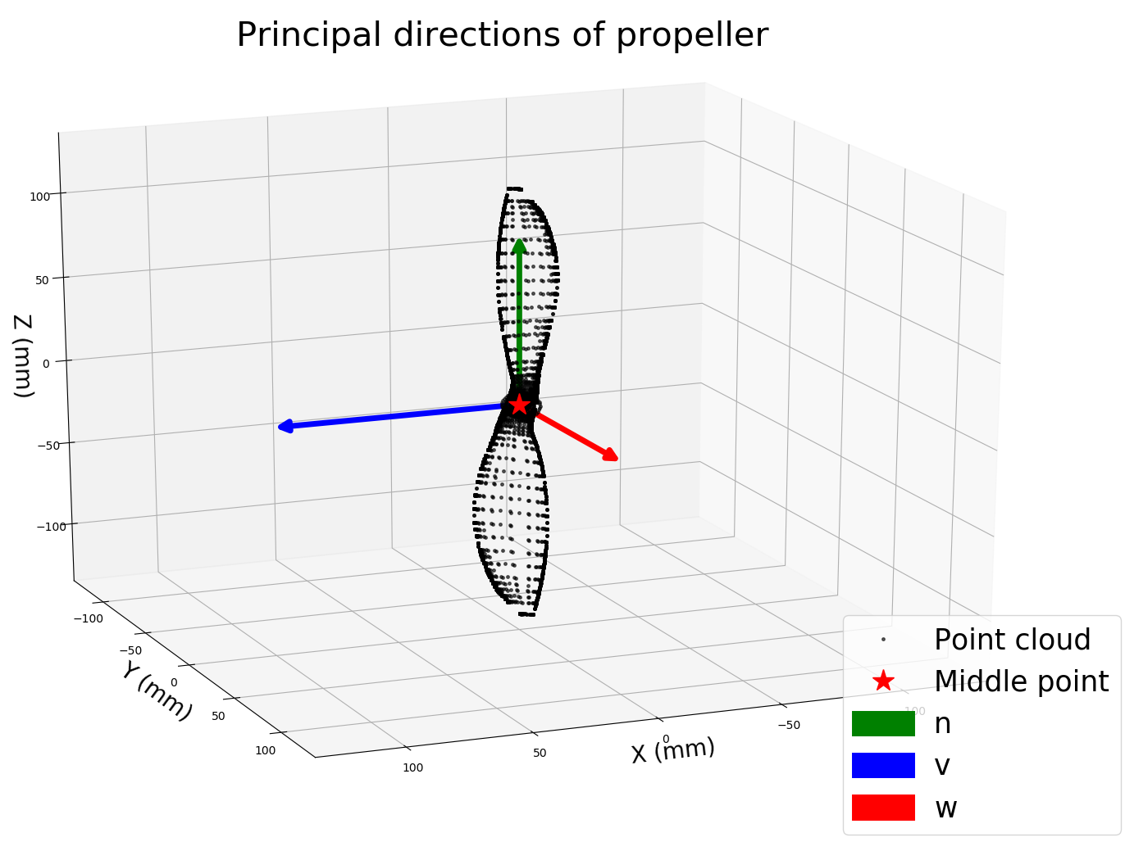
Methodology Step 1: Algorithm
Step 1: pre-processing
STL to CSV
Principal direction
Centering and rotating
Notes:
Prepare for the following
Removing redundant points

Slide 11

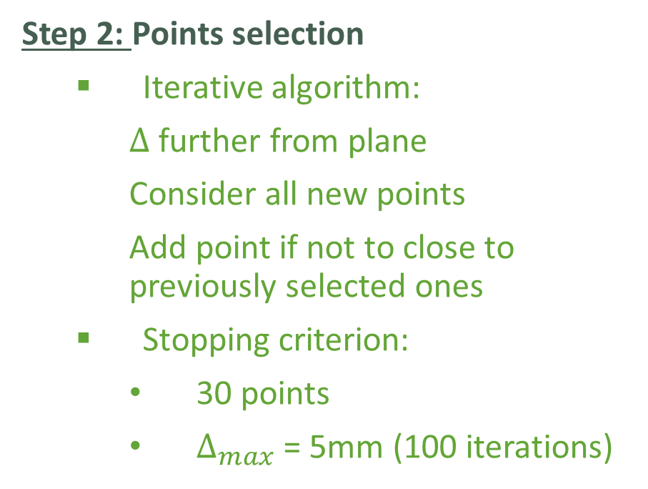
Methodology Step 2: Algorithm
Reality
Step 2: Points selection
Iterative algorithm:
$∆$ further from plane
Consider all new points
Add point if not to close to previously selected ones
Stopping criterion:
30 points
$∆_{max}$ = 5mm (100 iterations)
Cross-section
Δ = 0.05mm
Δ
Goal:
projection on cross section
Notes:
STEP 2: Points selection: which points belong to which aerofoil ?
At each step, we use an iterative algorithm, which consists of moving the plane further away from the initial one.
And then selecting points only if they are not to close to the previously selected ones.

Slide 12
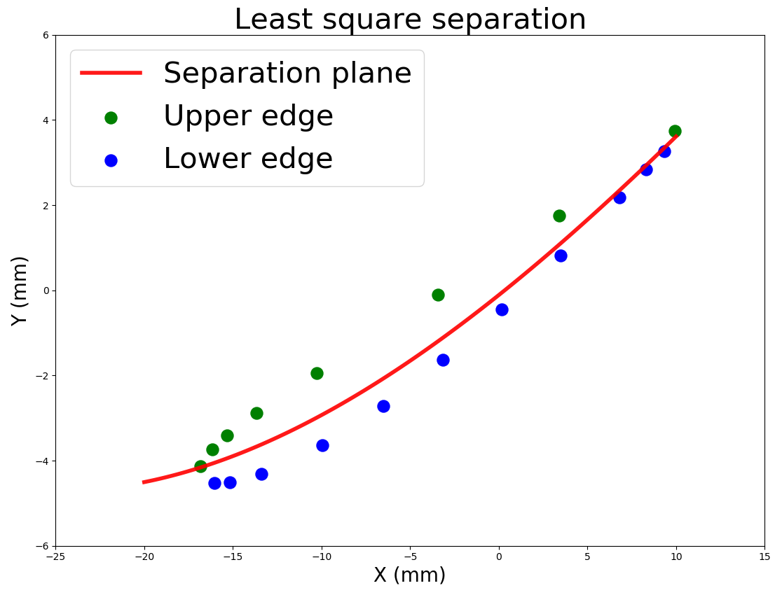
Methodology Step 3: Algorithm
Separation boundary
Lower surface
Upper surface
Step 3: Surface Separation
Least squares
Notes:
We want to know to which side of the aerofoil do the point belong to ?
We find the separation boundary by means of a least squares approximation which enables us to classify the points between the upper and lower surface.

Slide 13
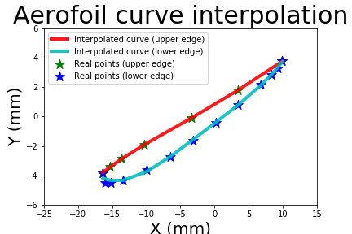
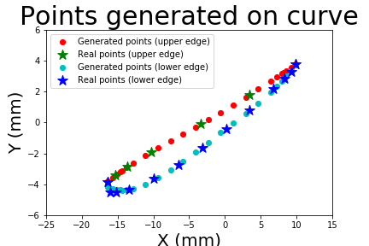
Methodology Step 4: Algorithm
Step 4: Curves interpolation (4th order polynomial) + continuity
Interpolated curve (lower surface)
Generated points (lower surface)
Interpolated curve (upper surface)
Real points (lower surface)
Real points (lower surface)
Generated points (upper surface)
Real points (upper surface)
Real points (upper surface)
Notes:
In fourth stage, we take the points from both the upper and lower surface to find the interpolation curve for the upper and lower surface. (LEFT)
We then use these interpolated curves to generate additionnal points as aerodynamic softwares require more points. (RIGHT)

Slide 14
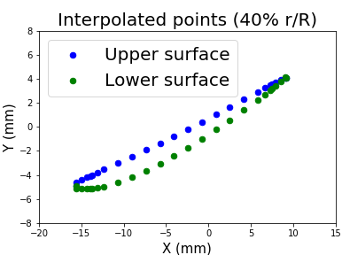
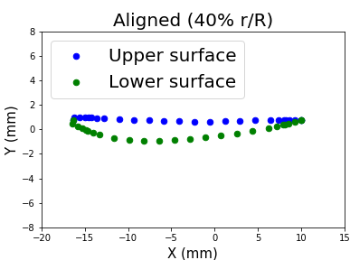
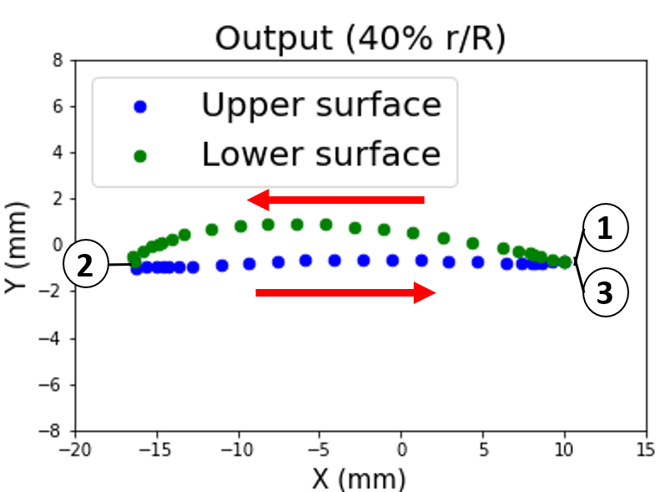
Methodology Step 5: Algorithm
Lower surface
Align with y=0
Upper surface
Lower surface
Mirror on y-axis
Upper surface
Lower surface
Upper surface
Step 5: X-Foil output
Align, mirror, (normalize), right order
Reynold and Mach

Slide 15
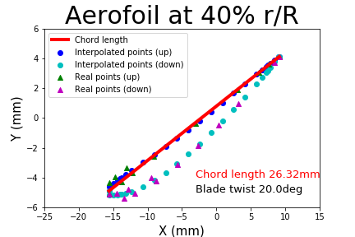
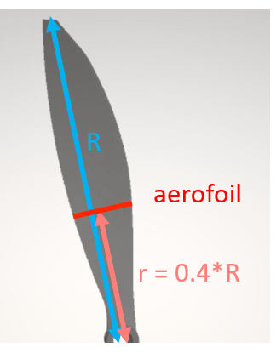
Methodology Step 6: Algorithm
Step 5: Parameters computation
Chord length
Blade twist
Blade twist angle

Slide 16
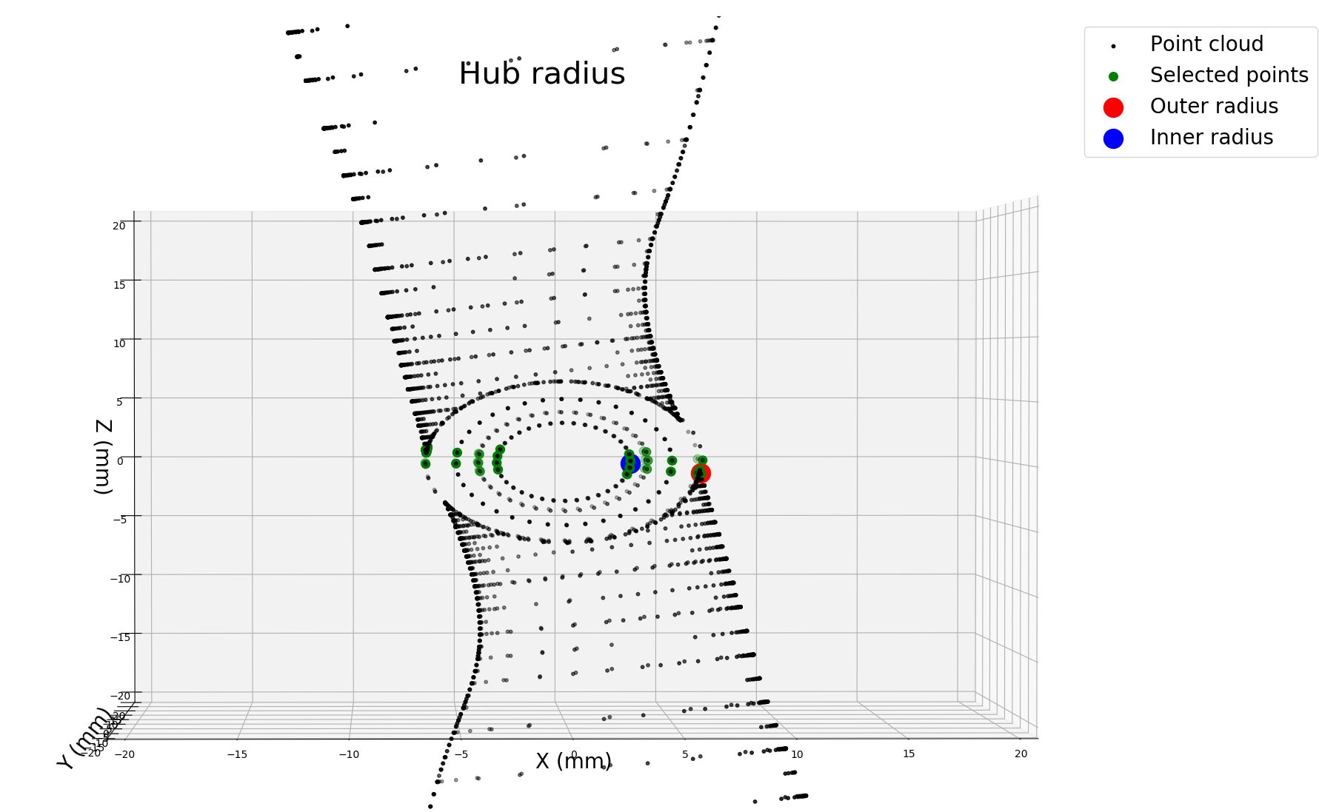
Methodology Step 6: Algorithm
Step 5: Parameters computation
Tip radius
Hub radius
Tip radius

Slide 17
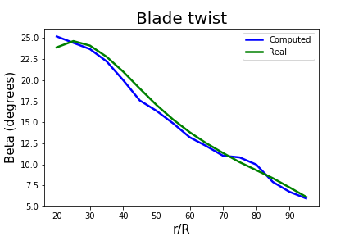
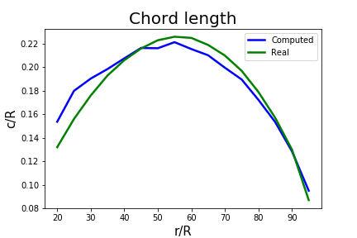
Results: Parameters
Chord length | Blade twist | Hub Radius | Tip Radius
RMSE 0.06 mm | RMSE 8.76 deg | Relative error 0.08 | Relative error 0.0015
 | Hub Radius | Tip Radius
Real | 7.15mm | 127mm
Computed | 6.54mm | 126.08mm

Slide 18
Results: Aerodynamic Software
Points output for each aerofoil:
With chord length and blade twist
With Reynolds and Mach numbers
Blade parameters
Tip radius, Hub radius
Applicable in different aerodynamic software programs
E.g: X-Foil but did not converge in viscid mode
Notes:
Unfortunately there is no convergence in viscid mode such that the parameters can not be found in xfoil

Slide 19
Outcome of the project
Ability to adapt to different scanning methods (Step 0)
And formats (STL not optimal)
Variable accuracy with points selection (step 2)
Customizable polynomial interpolation method (step 4)
Ability to perform detailed analysis with external software
X-Foil not converging: continuity of both curves
Future work: improve X-Foil or try other (Pablo [9], JavaFoil [10])
Notes:
Outcome
STL may be not the most appropriate format as the way it stores the shape of an object is through triangles. It leads to this problem where some parts are way more dense than others.

Slide 20
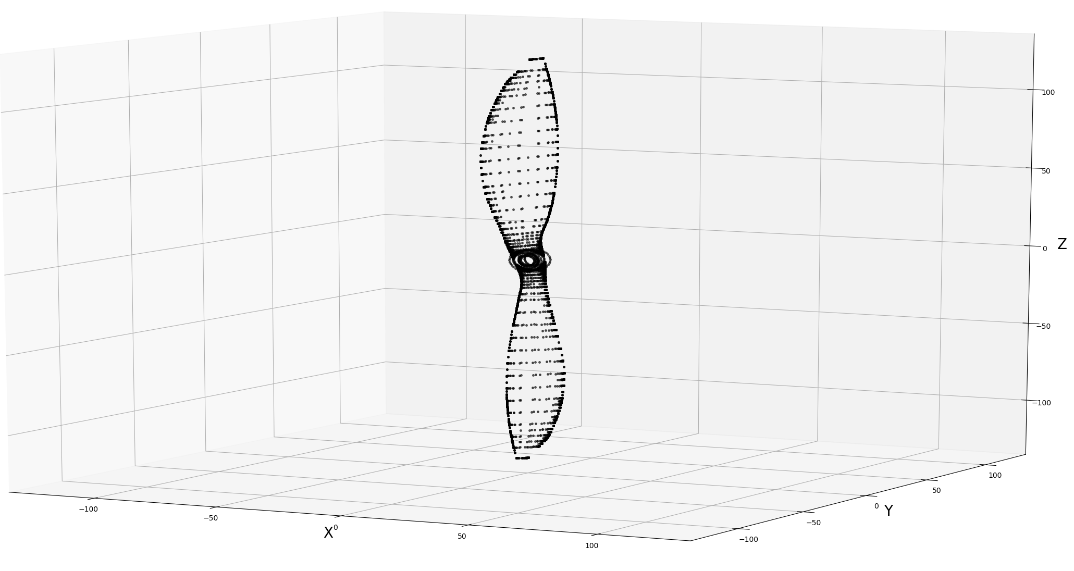
Conclusion
Reverse engineering algorithm for drone performance analysis
Aerofoil shape and parameters
New possibilities: scan and analyze
Compute performance
Reduce time at design phase
Notes:
State what have changed state of filed
Without: no way easily computing performnce with juste oject
Premise be able to scan and analyze, saving time at design phase
To conclude,
Goal: compute interesting parameter and shape information of propeller from 3D scanning data to be able to use BEMT on it
Done.
Still projections
Then Xfoil and parameters
Optionnal: find processes to further automate the 3D scanning of the propeller using examples of tools available on the market

Slide 21
Thank you for your attention

Slide 22
References
[1] A.W.L. Yao « Applications of 3D scanning and reverse engineering techniques for quality control of quick response products» Received: 2 October 2003 / Accepted: 27 January 2004 / Published online: 16 June 2004 © Springer-Verlag London Limited 2004
[2] Morteza Daneshmand, Ahmed Helmi, Egils Avots, Fatemeh Noroozi, Fatih Alisinanoglu, Hasan Sait Arslan, Jelena Gorbova, Rain Eric Haamer, Cagri Ozcinar, Gholamreza Anbarjafari. «3D Scanning: A Comprehensive Survey.» arXiv:1801.08863v1 [cs.CV] 24 Jan 2018
[3] Emmanuel P. Baltsavias. « A comparison between photogrammetry and laser scanning» Institute of Geodesy and Photogrammetry, Swiss Federal Institute of Technology, ETH-Hoenggerberg, CH-8093 Zurich, Switzerland Received 22 October 1998; accepted 17 March 1999
[4] Salunke, Nilesh P., Juned Ahamad R. A., and S.A. Channiwala. "Airfoil Parameterization Techniques: A Review." American Journal of Mechanical Engineering2.4 (2014): 99-102.
[5] Ava Shahroki Alireza Jahangirian Airfoil shape parameterization for optimum Navier–Stokes design with genetic algorithm. « Aerospace Science and Technology», Volume 11, septembre 2017
[6] Lu Xiaoqiang Huang Jun Song Lei Li Jing «An improved geometric parameter airfoil parameterization method.« Aerospace Science and Technology, Volume 78, July 2018
[7] from https://i.stack.imgur.com/Wo8E2.jpg
[8] from Ghassemi, H., & Zakerdoost, H. (2017). Ship hull–propeller system optimization based on the multi-objective evolutionary algorithm. Proceedings of the Institution of Mechanical Engineers, Part C: Journal of Mechanical Engineering Science, 231(1), 175–192. https://doi.org/10.1177/0954406215616655
[9] Pablo software: http://www.pdas.com/pablo.html
[10] JavaFoil Software: http://www.mh-aerotools.de/airfoils/javafoil.htm

Slide 23
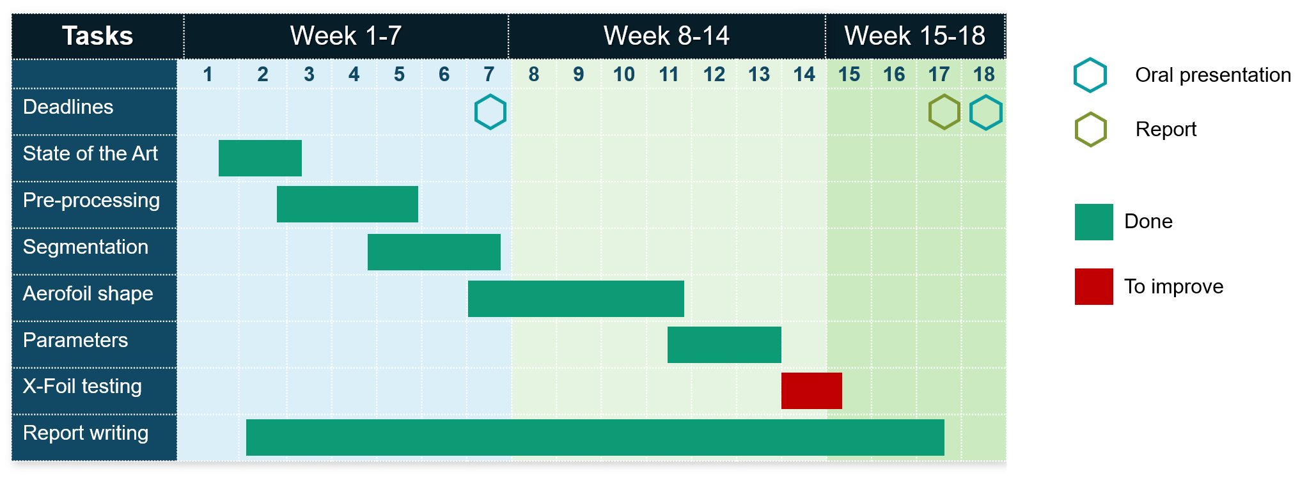
Gantt Chart
Notes:
MORE professonial drones
Point cloud into more useful parametrization
Output can be use for other programs drag..accurate modelling
Goal of project is mainly to analyze stl file + parameters and if possible input in external software for further nalysis
Decode stl
Get parmeters
Input for others software
Althiugh xfoil common, some reason input doesnt converge. Accuracy
Strong reason

